Slide 1
ConceptNet Analysis: Knowledge Graph vs. Relational DBMS Comparison
Data Management Project 2026
Project Group: Valerio Lorito (1885657) & Costanza Maiolino (2064531)

Slide 2
BACKGROUND
What is ConceptNet?
ConceptNet is a large-scale, multilingual knowledge graph that connects words and phrases through labeled, weighted semantic relationships.
5.7
36+
Latest Version
Languages
It integrates data from crowdsourced resources (e.g. Open Mind Common Sense), expert-curated databases (e.g. WordNet), and multilingual knowledge bases (e.g. Wiktionary, DBPedia).
~8M
~34M
Nodes
Edges
Example relationships:
dog —IsA→ animal
tree —PartOf→ forest
knife —UsedFor→ cutting
MAIN OBJECTIVE
COMPARE TWO DIFFERENT ARCHITECTURES FOR REPRESENTING AND QUERYING CONCEPTNET
SQL-BASED ARCHITECTURE — MYSQL vs. NOSQL-BASED ARCHITECTURE — MEMGRAPH

Slide 3
PIPELINE
Filtering Pipeline — Overview
1
2
-
3
4
English Filter
Biology Subgraph
Contract Definition
POS Tagging
Node Typing
→
→
→
→
Remove non-English
concepts
2-hop extraction
from root concepts
3 node types,
9 edge classes
URI → spaCy →
NLTK → WordNet → Heuristics
POS tag to
node type policy
FINAL DATASET
481,706 typed edges -> filtered as contract violations -> 454,139 loaded
291,746 typed nodes
Each step is implemented in Python scripts operating on the full ConceptNet 5.7 dump.

Slide 4
Schema Modeling — Node Types
Every concept in the subgraph is assigned to exactly one node type based on its Part-of-Speech tag.
1
EntityNode
Concrete or abstract things, substances, organisms, locations, and structures.
POS TAG 'n' (NOUN)
e.g. cell, protein, organism, molecule, forest, enzyme, habitat, tissue, species
2
ActionEventNode
Biological processes, actions, events, and state changes.
POS TAG 'v' (VERB)
e.g. evolve, photosynthesize, digest, replicate, mutate, metabolize, divide, absorb
3
PropertyNode
Observable qualities, measurable attributes, and relational descriptors.
e.g. toxic, aquatic, organic, rapidly, hereditary, microscopic, cellular, parasitic
‘a’ (ADJECTIVE)
POS TAGS : ‘r’ (ADVERB)
‘s’ (SATELLITE ADJECTIVE)
This POS-based classification provides a clean, deterministic partition — every concept maps to exactly one node type with no ambiguity.

Slide 5
Schema Modeling — Edge Classes
Each edge is classified into one or more of classes, based on the types of its source and target nodes.
(Edge classes were determined by analyzing which ConceptNet relations semantically apply between each pair of node types).
Entity → Entity
12
IsA, PartOf, MadeOf, DefinedAs, InstanceOf, SymbolOf, FormOf, LocatedNear, AtLocation, EtymologicallyRelatedTo, EtymologicallyDerivedFrom, DerivedFrom
Entity → Property
3
HasProperty, NotHasProperty, DefinedAs
Entity → Action
7
CapableOf, UsedFor, ReceivesAction, NotCapableOf, Desires, NotDesires, CreatedBy
Action→ Action
7
HasSubEvent, HasFirstSubevent, HasLastSubevent, HasPrerequisite, Entails, MannerOf, MotivatedByGoal
Action → Property
2
HasProperty, NotHasProperty
ALL (any ↔ any)
9
DBPedia, Causes, CausesDesire, DistinctFrom, RelatedTo, Synonym, Antonym, SimilarTo, HasContext
The edge-class taxonomy also defines Property→Property, Property→Entity, Property→Action and Action→Entity as valid classes. However, these classes are empty in the final subgraph — these classes carry zero edges in this slice. They remain in the schema for completeness but carry zero edges.

Slide 6
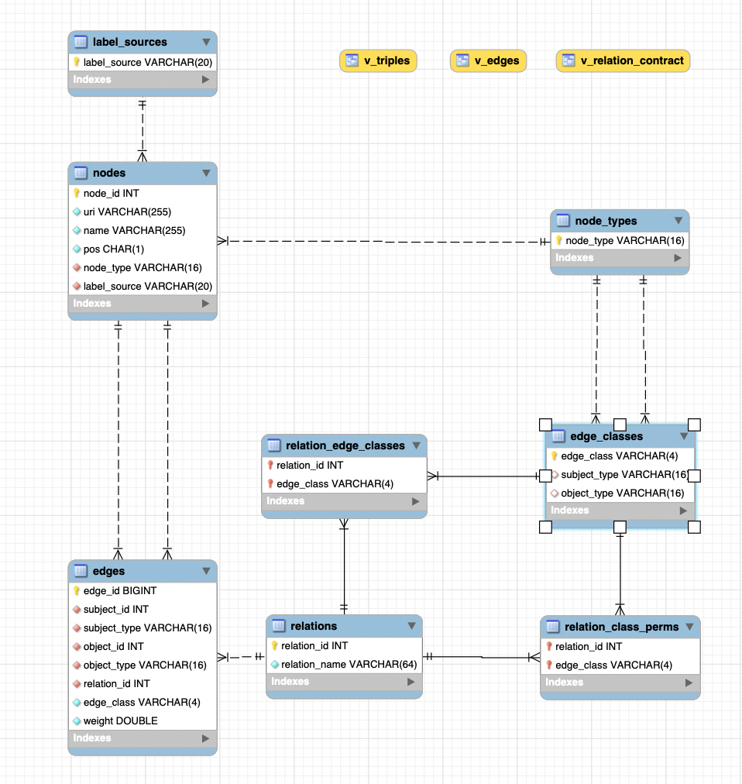
Relational Architecture (SQL)
Entity-Relationship modeling for ConceptNet 5.7 structured data.
Normalized Tables
Strict separation of nodes, edges, and classification taxonomy to minimize redundancy.
Foreign Key Constraints
Referential integrity enforced natively across all relational mapping tables.
JOIN-Dependent Traversals
Multi-hop paths require computationally expensive nested JOIN operations.

Slide 7
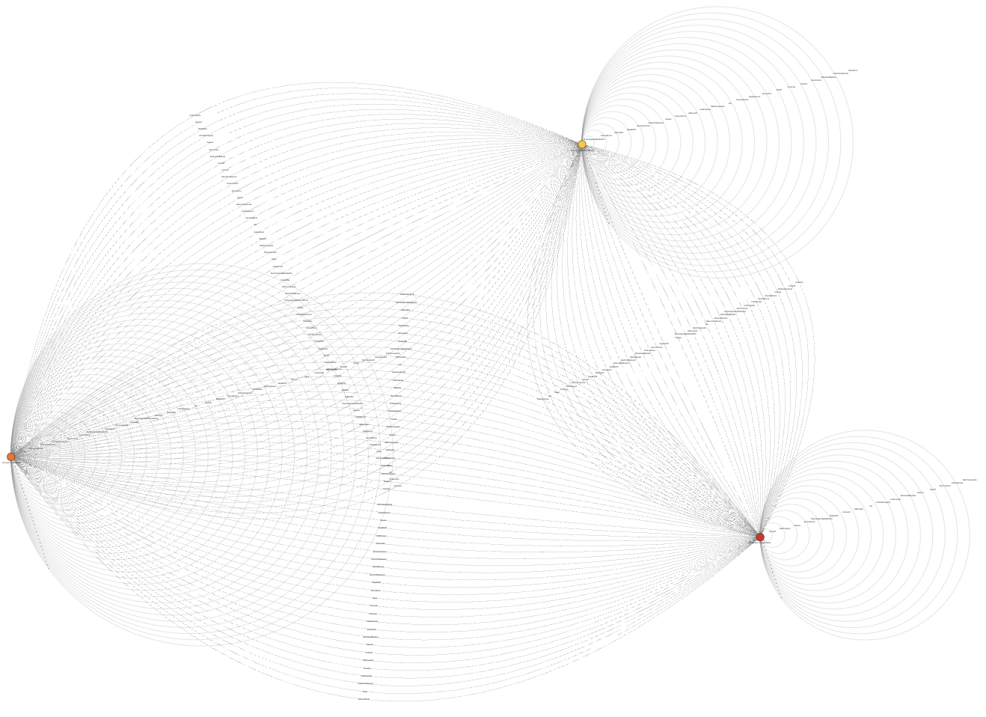
Native Graph Architecture (Memgraph)
Property graph model optimized for semantic relationship traversals. Visually, a giant mess…
First-Class Relationships
Edges are stored directly as native entities, not computed at query time.
Index-Free Adjacency
Nodes hold direct memory pointers to connected neighbors for O(1) hops.
Schema Flexibility
Properties attached dynamically to nodes and edges without rigid table definitions.

Slide 8
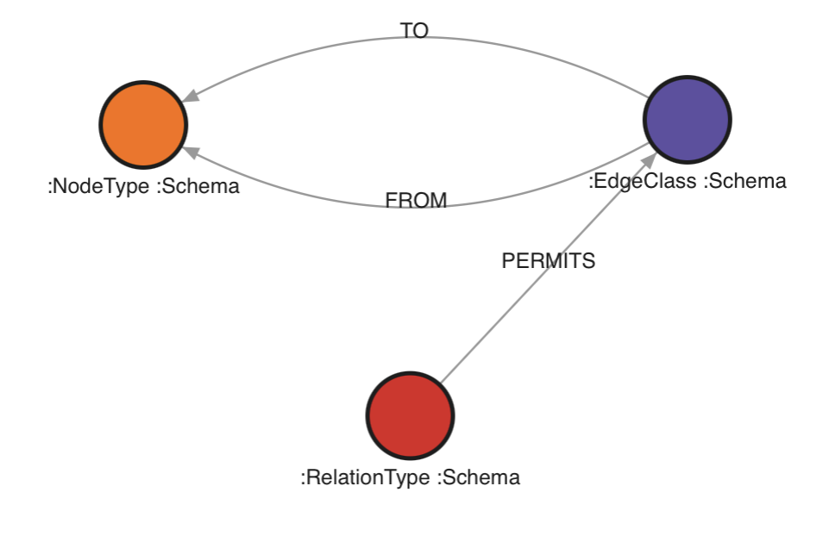
Memgraph Permission Meta-Graph
Since Memgraph has no built-in schema enforcement, the edge-class contract is encoded as a separate graph structure — queryable at validation time.
The Need of a Permission Schema
Memgraph accepts any edge between any nodes — there are no CHECK constraints, no foreign keys, no endpoint-type rules on relations. An invalid edge (e.g. HasProperty between two EntityNodes) is silently inserted.
Violation Detection at Query-Time
This meta-graph acts as a declarative permission layer that can be queried to detect violations.
Differences from MySQL
|—FROM→ EntityNode
|
Example: IsA —PERMITS→ E2E
|
|—TO→ EntityNode
In MySQL, this contract is intrinsic to the relational schema: CHECK constraints validate edge classes at insertion, composite foreign keys enforce endpoint types, and the v_edges view flags violations automatically.

Slide 9
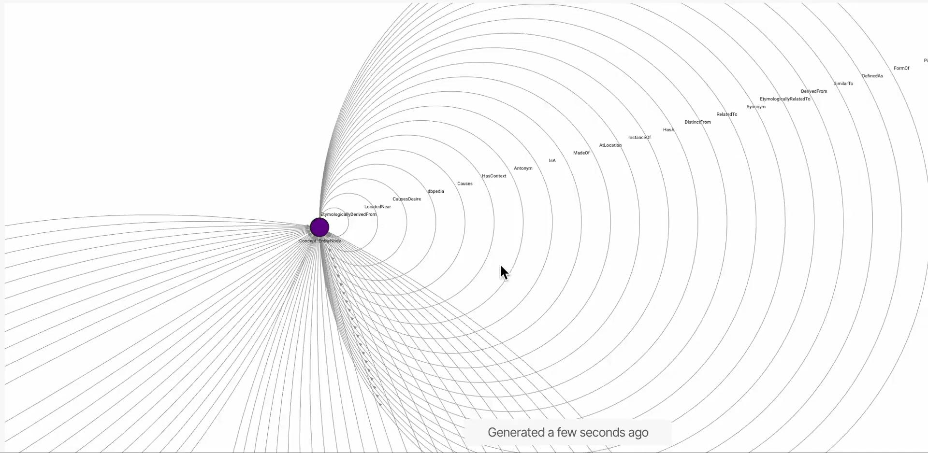
Memgraph Architecture:

Slide 10
QUERY SUITE
Comparative Query Analysis
We designed four query families to evaluate different categories of inference that can be performed on a knowledge graph, testing both architectures on information retrieval capabilities and schema integrity enforcement.
Every result was verified: result-set hashes were compared across engines to ensure functional equivalence, and isomorphic loads were asserted per run to guarantee both architectures operated on identical data. Cross-verification surfaced five classes of silent error (query-text desyncs, grouping ambiguity, pattern-semantics differences, planner access paths, contract drift) — each fixed and viewable..
Analysis Objectives
Measure the overhead of SQL JOINs vs graph pattern matching on equivalent queries.
Compare B-Tree indexed lookups (MySQL) against in-memory adjacency pointers (Memgraph) for local retrieval operations.
Evaluate how execution time scales with traversal depth — identifying the crossover point where graph-native traversal outperforms relational joins.
Test queries that expose expressiveness gaps — operations native to Cypher with no practical SQL equivalent.
Assess full-graph aggregation throughput, where both engines must scan the entire edge set.
Verify schema integrity enforcement: preventive (MySQL CHECK + FK at write time) vs detective (Memgraph meta-graph validation at query time).
Compare referential integrity handling on write operations — insertion of invalid data and cascading deletions.

Slide 11
QUERY SUITE — FAMILY A
Family A: Local Retrieval
Evaluates basic read operations, indexing efficiency, and single-hop adjacency. Designed to test the baseline overhead of SQL JOINs against direct memory pointers.
Node Searching
1-Hop Expansion
Pattern Intersections
Exact URI matches.
Alphabetical range scans.
Targeted relation queries.
Bidirectional traversal tracking.
Shared neighbor identification.
Relational set difference.
A1
Single Node Search — Find a concept by its URI — primary key index lookup.
A6
Range Selection — All concepts whose name falls within a lexicographic range (e.g. 'cell' to 'gene').
A2
Full Relation Table — All outgoing relations of a concept, ranked by weight.
A3
Relation 1-hop — Follow a specific relation to a target node type (e.g. cell→CapableOf→Action).
A4
Directed vs. Undirected — Compare incoming-edge lookup with bidirectional traversal on symmetric relations.
A5
Relation Pair Intersection — Concepts related to both A and B via the same relation type.
A7
Neighborhood Difference — Concepts related to A but not to B — tests anti-join / NOT EXISTS.
2

Slide 12
BENCHMARK — FAMILY A
Local Retrieval — Results
SQL wins on most local queries thanks to B-Tree indexing and optimized JOINs.
Memgraph advantage appears on undirected traversals (A4b) and set-difference patterns (A7) where Cypher's syntax maps directly to the operation.
Differences under ~1–2 ms reported as ties; medians over N runs; all result sets hash-verified.
Query
SQL (ms)
Cypher (ms)
Winner
Analysis
A1
0.25
32.34
SQL
URI lookup: SQL 94x faster - Memgraph’s property index wasn’t used for this lookup.
A2
0.51
1.64
SQL
Relation table: SQL 2.8× faster — JOIN chain well-optimized by MySQL planner.
A3
0.39
0.95
Tie
1-hop typed: near tie — both engines handle single-hop efficiently.
0.47
0.93
SQL
Directed (reverse): SQL slightly faster on incoming-edge indexed lookup.
A4a
Tie
A4b
5.54
1.08
Graph
Undirected: Memgraph 3.4× faster — bidirectional pattern matching is native.
A5
3.70
1.19
Graph
Pair intersection: Memgraph 3.1x faster - the pattern expresses the join topology directly; SQL pays the two-branch self-join
A6
133.80
728.32
SQL
Range scan (60k rows): SQL faster — B-Tree range scans are SQL's sweet spot.
A7
1.23
0.46
Graph
Set difference: Memgraph wins — NOT EXISTS is more natural in Cypher.

Slide 13
QUERY SUITE — FAMILY B
Family B: Traversal Paths
Multi-hop explorations, shortest paths, and recursive traversals. Tests the core trade-off: SQL recursive CTEs with manual cycle detection versus Cypher's native variable-length patterns.
Multi-Hop Exploration
Path Finding
Structural Patterns
Weight-filtered neighborhood.
Hierarchical IsA chains.
BFS shortest path.
Weight-product path scoring.
Cycle / triangle detection.
Neighbor degree profiling.
B1
K-Hop Neighborhood — All concepts reachable in K hops, filtered by minimum edge weight.
B2
Transitive Closure — Follow IsA chains up to depth 5 — find all superclasses of a concept.
B3
Shortest Chain — Shortest undirected path between two concepts via BFS (any relation).
B4
Weighted Path Scoring — Rank paths by product of edge weights. No SQL equivalent exists.
B5
Anchored Triangle — 3-hop cycles starting and ending at the same concept (structural motif).
B6
Degree Profile — For each neighbor, count its outgoing degree — local centrality analysis.

Slide 14
BENCHMARK — FAMILY B
Traversal Paths — Results
The K-hop crossover at k=4 is the headline result: SQL wins at shallow depth, but Memgraph's O(1) pointer traversal scales better. For path-finding (B3), Memgraph is 16× faster and B4 has no SQL equivalent — the strongest argument for a graph engine on this workload.
Median execution time (ms). B4 excluded (no SQL counterpart —Memgraph executes in 3.55 ms since path queries are natively efficient).
Query
SQL (ms)
Cypher (ms)
Winner
Analysis
B1k1
0.37
0.43
Tie
1-hop weighted: near tie - minimal traversal, both fast.
B1k2
0.38
0.51
Tie
2-hop: SQL still ahead - JOINs competitive at shallow depth.
B1k3
0.54
0.93
SQL
3-hop: gap narrowing - SQL's JOIN cost growing with depth.
B1k4
3.78
2.32
Graph
4-hop: crossover - Memgraph overtakes as index-free adjacency pays off.
B2
0.33
0.40
Tie
Transitive closure (IsA, depth 5): near tie - recursion frontier stays small, so recursive CTE is cheap.
B3
1638.09
89.96
Graph
Shortest path BFS: Memgraph 16.6× faster - native BFS vs. recursive CTE.
18.81
19.64
SQL
Anchored triangle (3-hop cycle) — near tie, both handle triple-JOIN well.
B5
Tie
B6
15.05
6.01
Graph
Degree profile: Cypher slightly faster — traversal feeds aggregation without JOINs.
Cypher advantage: path queries (B3, B4) are native 1-liners — SQL requires recursive CTEs, JSON path tracking, and UNION ALL.

Slide 15
QUERY SUITE — FAMILY C
Family C: Global Retrieval
Full-graph aggregations scanning the entire dataset. Measures raw throughput on large GROUP BY operations — where both engines need to touch every edge and the performance gap narrows.
Degree Analytics
Schema Cross-Tabulation
Full edge-set scan.
Top-K ranking by out-degree.
Per-relation, per-class aggregation.
Edge count + average weight matrix.
C1
Concept Hubs Ranking — Top-10 concepts by outgoing edge count — full GROUP BY on all edges.
C2
Relation-Class Matrix — Group all edges by (relation, edge_class) — cross-tab of the entire schema.

Slide 16
QUERY SUITE — FAMILY D
Family D: Schema & Integrity
Constraint enforcement, violation detection, and data mutation. Evaluates how each architecture handles schema validation at write time and referential integrity during deletions.
Constraint Validation
Data Mutation
A priori type-contract check.
Preventive vs. detective approach.
Cascading deletion.
Referential integrity handling.
D1
Violation Check — Count edges violating the type contract. MySQL uses v_edges view; Memgraph queries :Schema meta-graph.
D2
Invalid Insert — Insert a contract-violating edge. MySQL rejects (CHECK + FK); Memgraph accepts silently.
D3
Concept Delete — Remove a concept and all incident edges. MySQL: ordered DELETE (FK order); Memgraph: DETACH DELETE.
Key insight: MySQL enforces schema at write time (preventive) — Memgraph relies on query-time validation (detective).

Slide 17
BENCHMARK — FAMILIES C & D
Global Retrieval & Schema Integrity
Median execution time (ms). All results verified OK.
Q
SQL
Cypher
Win
Key Finding
C1
894.57
555.87
Graph
Hub ranking — Memgraph 1.6× faster. SQL pays join-backs to nodes / relations.
C2
576.22
163.68
Graph
Relation-class matrix — Memgraph 3.5× faster. Same reason as C1 analysis.
D1
67.44
4556.20
SQL
Violation check — MySQL checks the contract via a view over reference table, while Memgraph runa a per-edge anti-join.
D2
75.20
4664.76
SQL
Invalid Insert -MySQL rejects 2 of 3 invalid inserts at write time (CHECK 3819, FK 1452); the third (truthful class, unpermitted combo) loads flagged ‘permitted=0’. Memgraph accepts all three silently
D3
2.45
30.39
SQL
Concept delete — MySQL fails at deleting the parent first (FK 1451; children must go first). Memgraph uses one atomic ‘DETACH DELETE’, no order needed.
Qualitative Observations
Family C — Graph wins both
Family D — SQL wins all three
In-memory iteration over all 454k edges is faster than disk-based InnoDB page reads. The gap widens on C2 (3.5×) where Memgraph's label-based CASE avoids the JOIN to the relations table.
MySQL enforces constraints at write time (preventive): CHECK + FK reject invalid data instantly. Memgraph accepts silently and validates retroactively via the :Schema meta-graph — ~68× slower.
Memgraph dominates global aggregations (C). MySQL dominates schema enforcement (D) — a fundamental architectural difference.

Slide 18
CONCLUSION
MySQL vs Memgraph — Final Verdict
MySQL
Memgraph
Excels when the workload is structured
Excels when the workload is navigational
Point & range access: B+ tree equality and range scans dominate local retrieval — shallow joins are cheap for the planner.
Deep traversal: index-free adjacency wins as hops compound — crossover at k = 4 (B1), 16× on shortest path (B3)
Integrity at write time: CHECK + composite FKs reject invalid data on insert (D2: 3819/1452) and prevent orphaning on delete (D3: 1451) — no query needed.
Path-shaped questions: variable-length patterns are native; B4 has no SQL formulation— recursive CTEs only approximate it.
Contract as catalog: the type contract is a declared schema; checking it is a view over reference tables — 68× faster than query-time validation (D1).
Undirected & difference patterns: one pattern where SQL needs OR-predicates or anti-joins (A4b, A7).
Durable & compact: 186 MB on disk with persistence by default — vs. 1.54 GiB resident in RAM.
Full-graph aggregation: reads labels/properties off traversed records — no join-backs to reassemble tuples (C1, C2: up to 3.5×).
Bottom line: Neither architecture dominates: the winner is decided by the shape of the question. Local lookups, declared integrity, and compact durability favor MySQL; multi-hop navigation, path semantics, and whole-graph aggregation favor Memgraph — and only the relational engine can guarantee the contract, while only the graph engine treats paths as data.

Slide 19

Thank you for the attention
Valerio lorito

